Slide 1
Cybersecurity
Zero-Day Attacks

Slide 2

Zero-Day Attacks
Any software can have vulnerabilities
Some are known, some unknown
When a weakness is found, there’s a choice:
White hats tell the developer so patches can be made
Sometimes a “bug bounty” will be paid
Black hats keep it to themselves
Or sell to the highest bidder

Slide 3

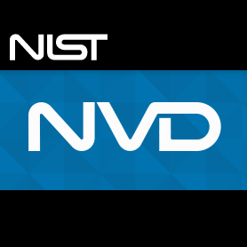
Known Vulnerabilities
Common Vulnerabilities and Exposures (CVE)
www.cve.mitre.org
National Vulnerability Database (NVD)
nvd.nist.gov
Operated by NIST
Supported by DHS’s Cybersecurity and Infrastructure Security Agency (CISA)
Researchers and cybersecurity analysts report vulnerabilities to CVE and NVD for others to learn/benefit
Discovered on their own
Found “in the wild” (in use somewhere)
Open Source Intelligence = sharing knowledge

Slide 4

Zero-Day
Number of days an exploit is known grows from the day it was discovered
Day Zero is day it is discovered
Each day +1
Day Seven would be 7 days since the exploit was made known
Day 365 is 1 year since exploit was made known
Lower the number, less likely a patch exists
Zero Day attacks are heretofore unknown
New, novel attacks
Unknown, unpatched

Slide 5
Zero-Day Vulnerabilities
March 2017
CVE-2017-0199 – Microsoft Office/WordPad Remote Code Execution Vulnerability with Windows API
Open a Microsoft Office or WordPad file
SophosLabs documented attacks in the wild since Nov 2016
June 2017
CVE-2017-8543 | Windows Search Code Remote Code Execution Vulnerability
Send a specially crafted SMB message to the search service
Install programs, view/change/delete data, and/or create new user accounts

